Slide 1
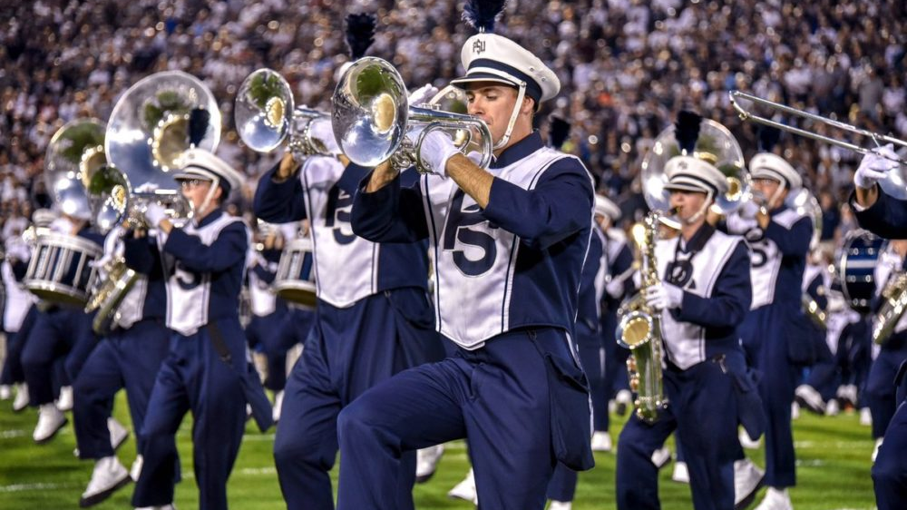
Notes:
Music: “Let Go” Judah & The Lions
Music fades in, slowmo panning shot

Slide 2
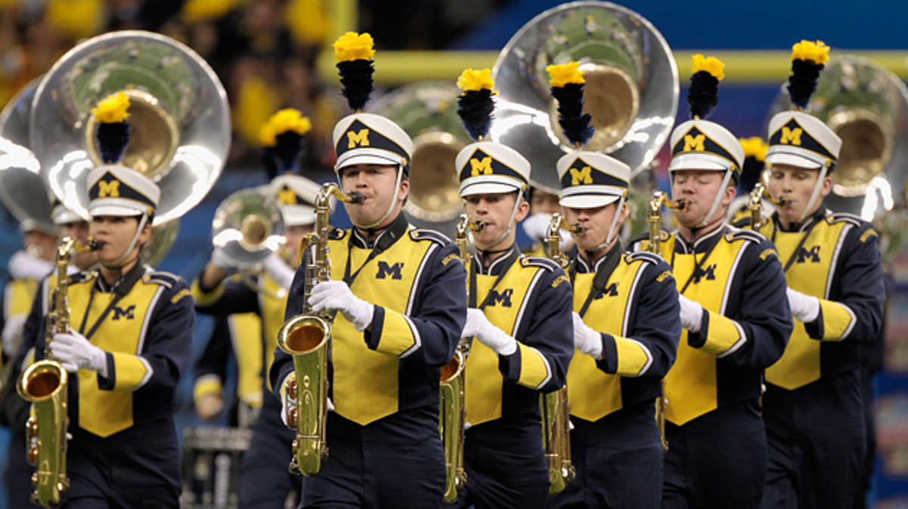
Notes:
Slowmo panning shot

Slide 3
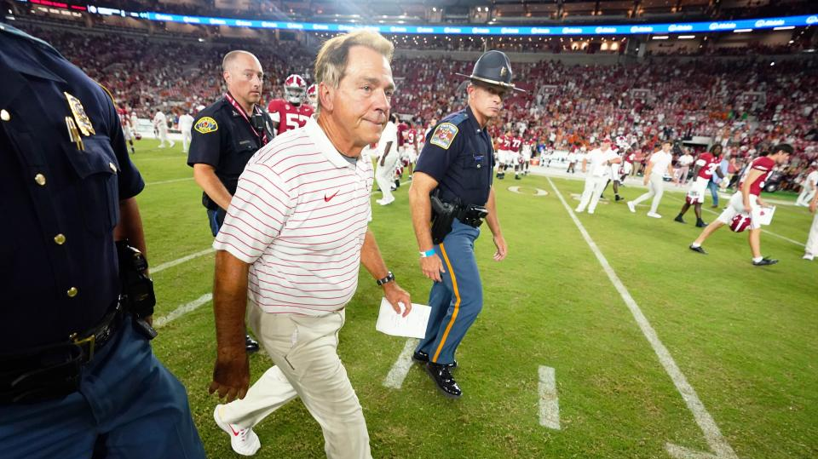
Notes:
slowmo

Slide 4
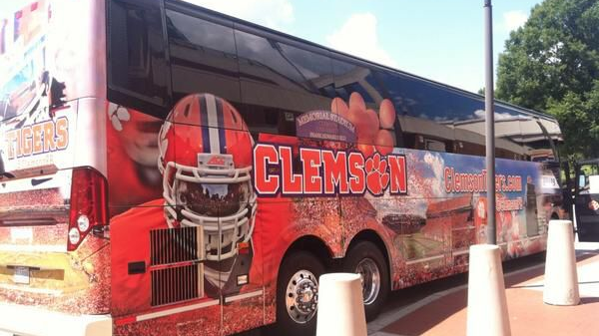
Notes:
Slowmo panning of bus pulling up

Slide 5
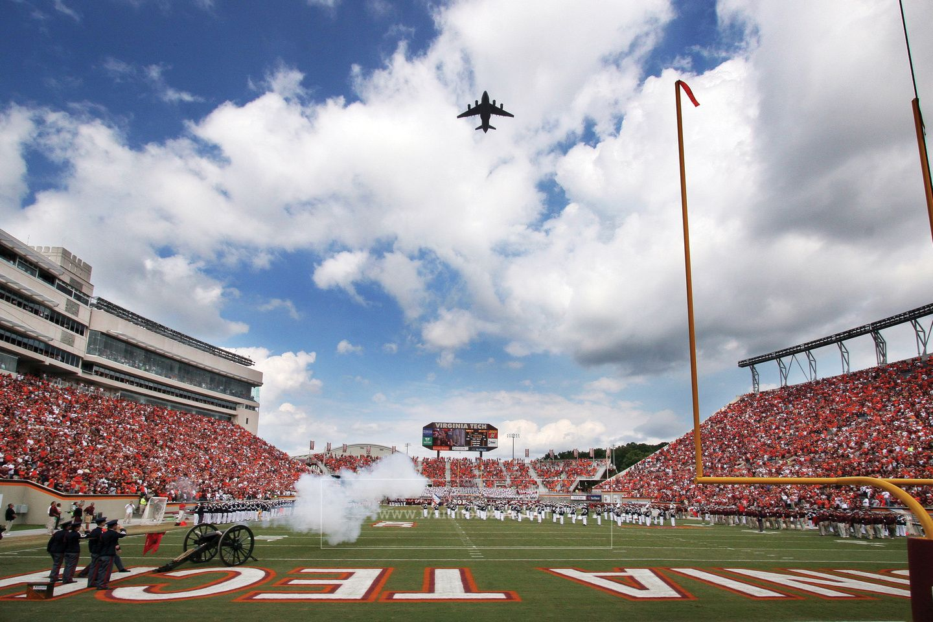
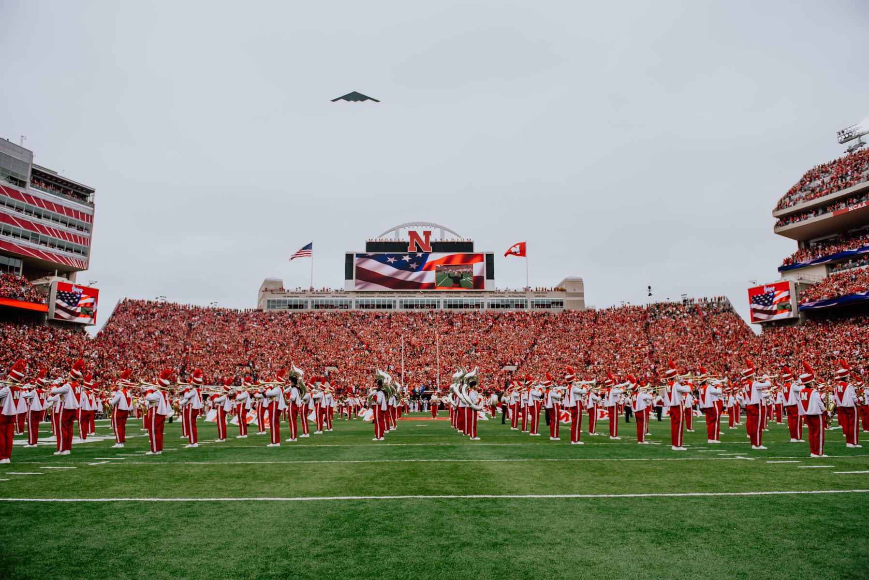
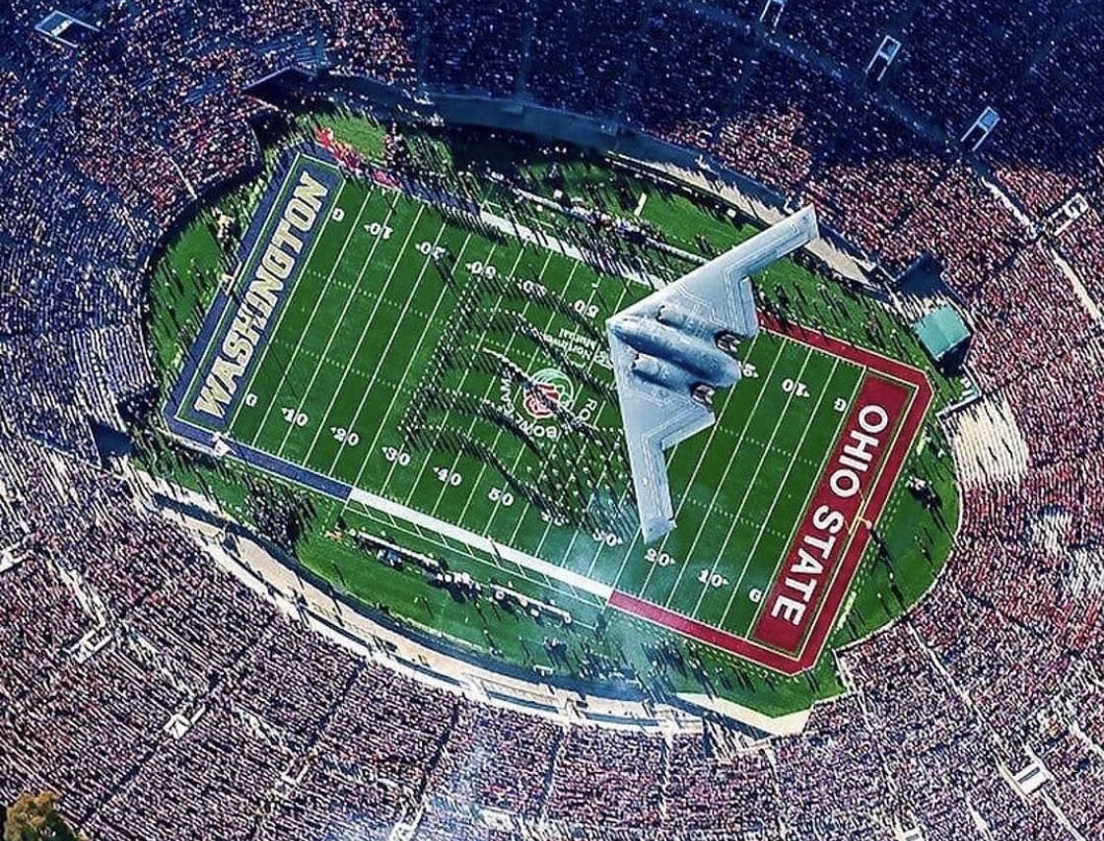
Notes:
Low angle tracking shot
Slowmo pan
High angle tracking flyover

Slide 6
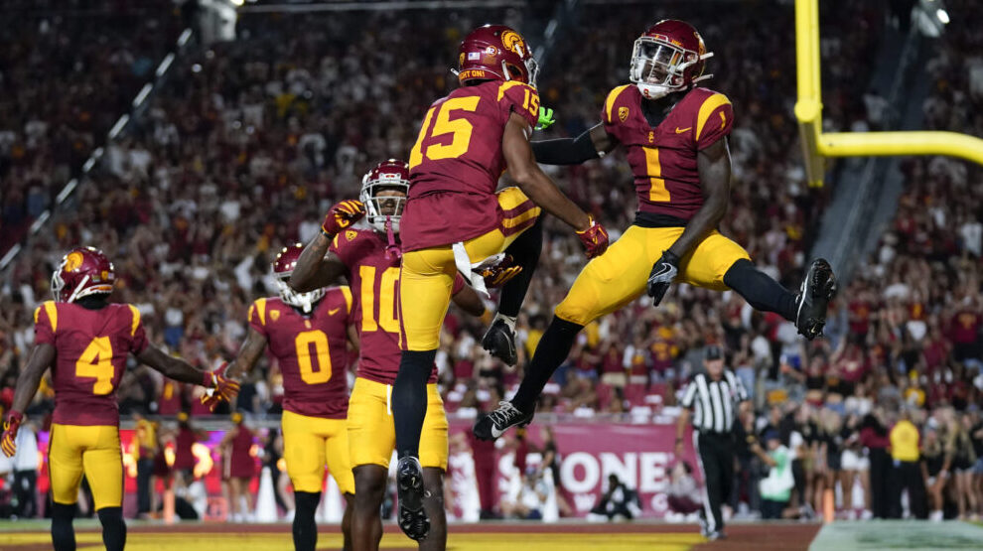
Notes:
Speedramp the jump

Slide 7
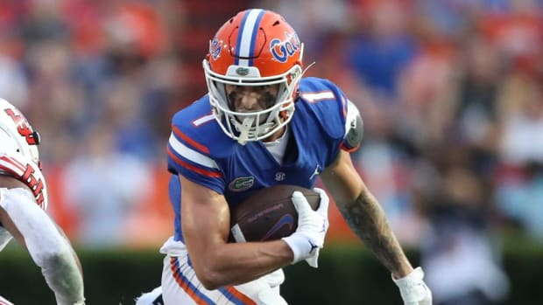
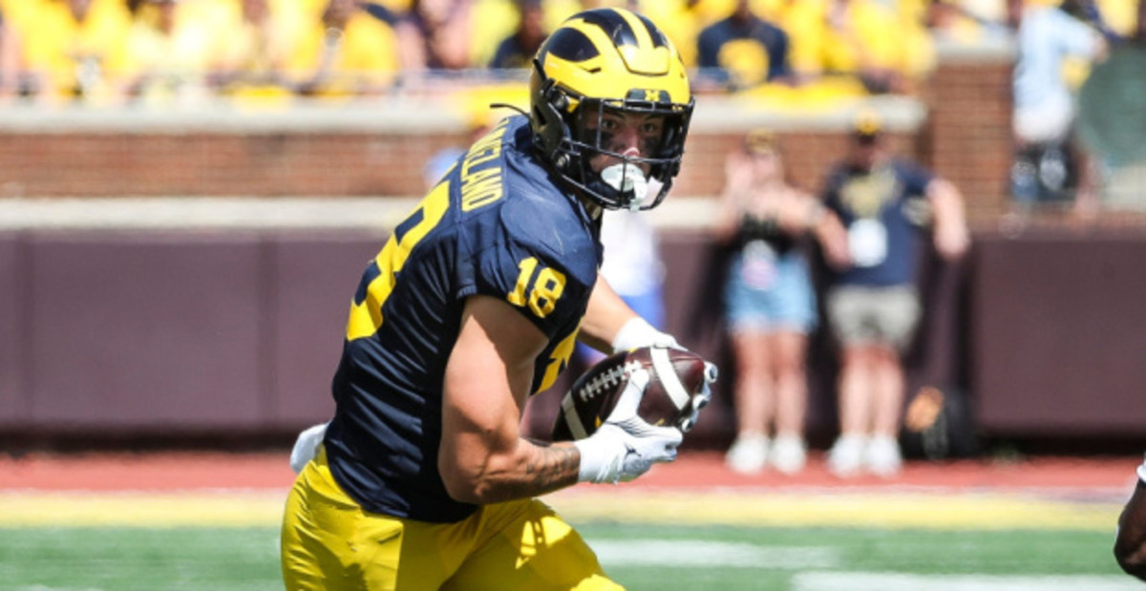
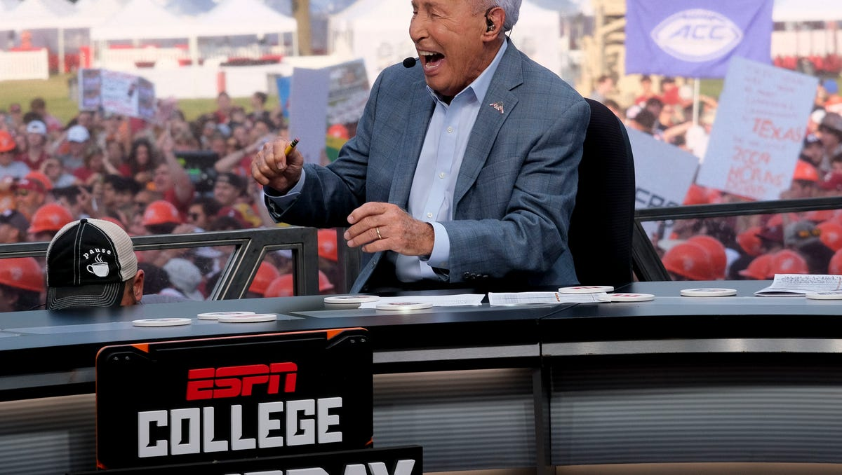
Notes:
Slowmo running followed by speed ramp transition into Michigan player running. Wipe transition to slowmo pan of front desk

Slide 8

Notes:
Jump cut slommo motion track of midshipmen jumping up and down

Slide 9
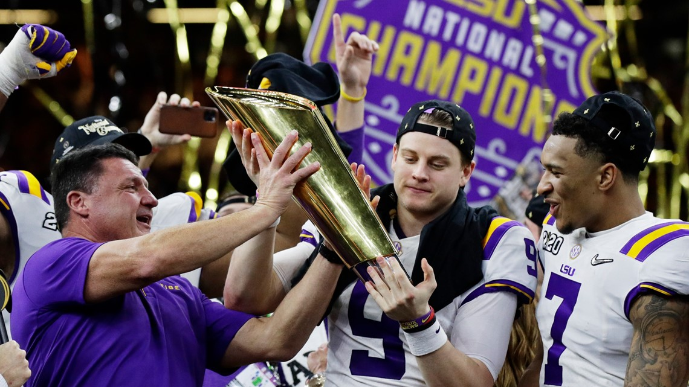
Notes:
Slowmo tracking of trophy hoist

Slide 10
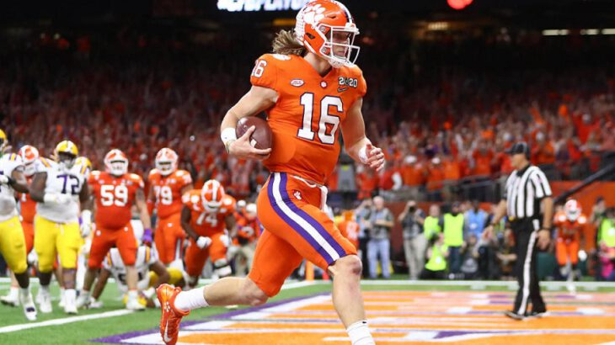
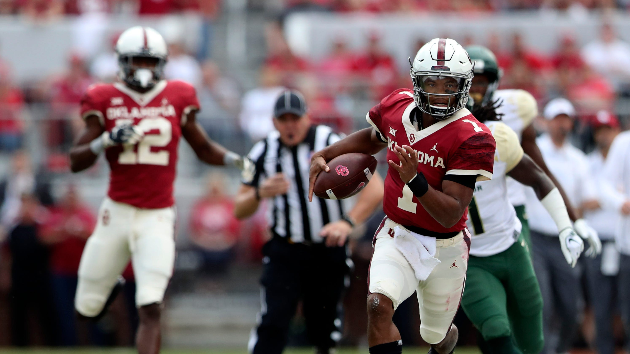
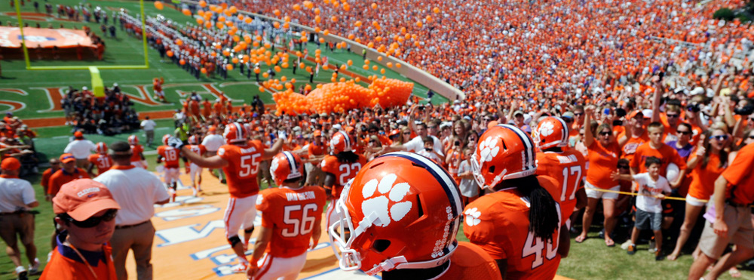
Notes:
Tracking speedramp into the end zone
Wipe into running back
Bouncing motion track run down hill from howard’s rock

Slide 11
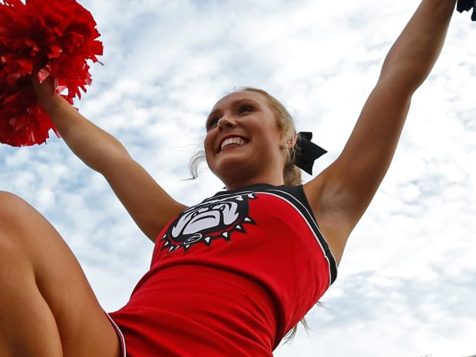
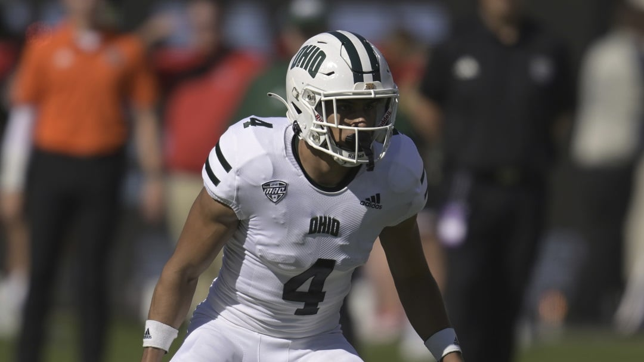
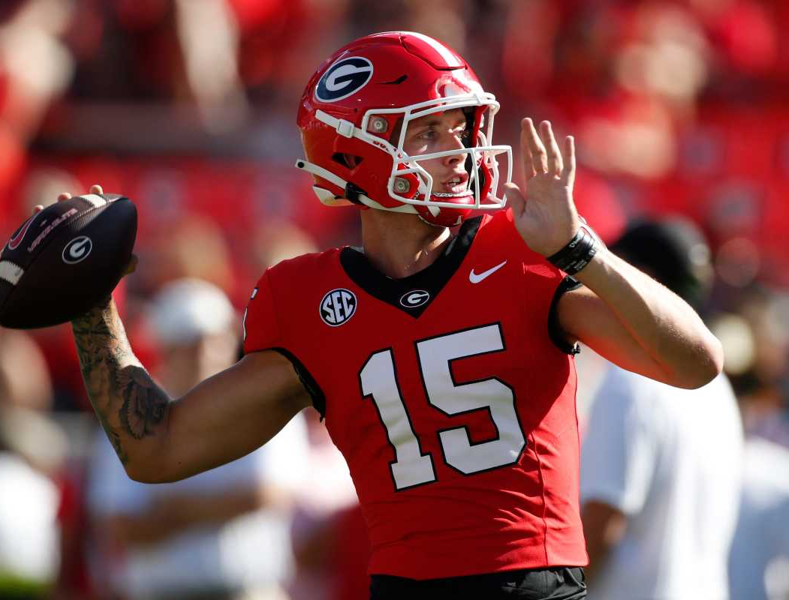
Notes:
Quick wiping shot

Slide 12
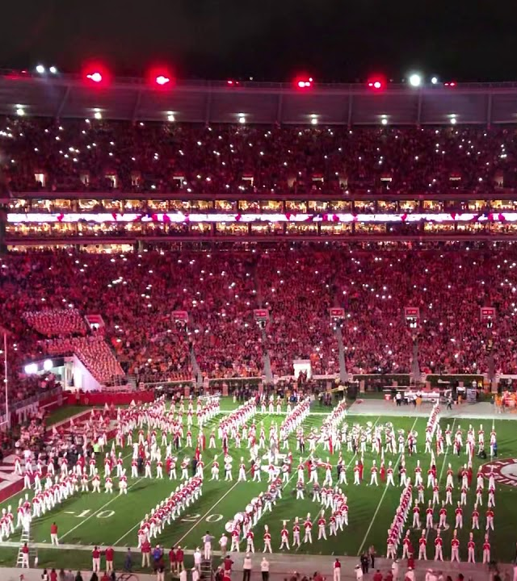
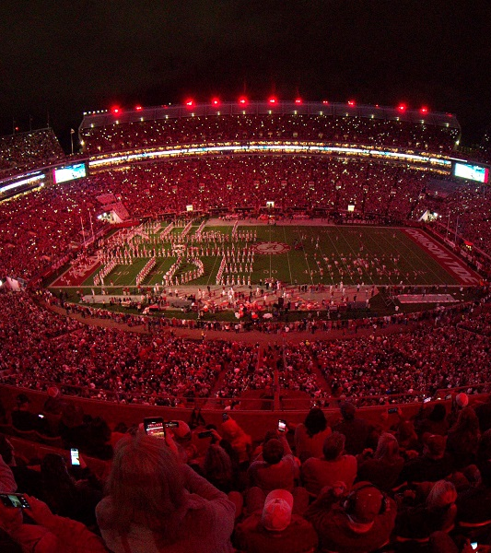
Notes:
First shot pan left
Fade into paning shot to the right

Slide 13
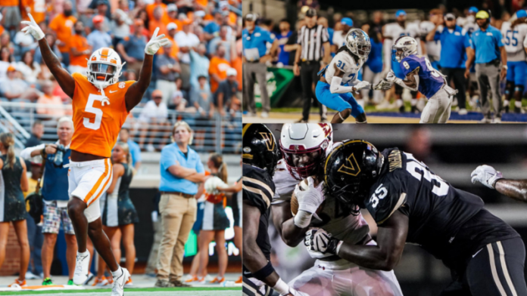
Notes:
Quick cuts between bass drum, speed ramp to match tempo

Slide 14
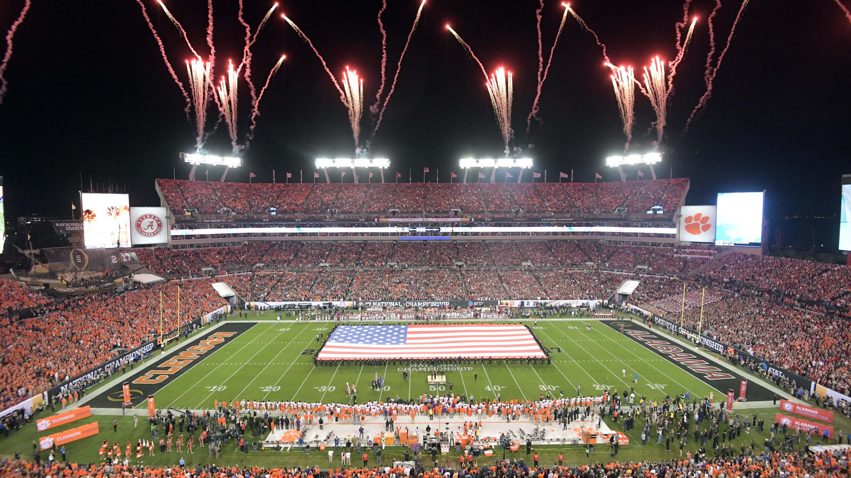
Notes:
Slowmo pan left to right

Slide 15
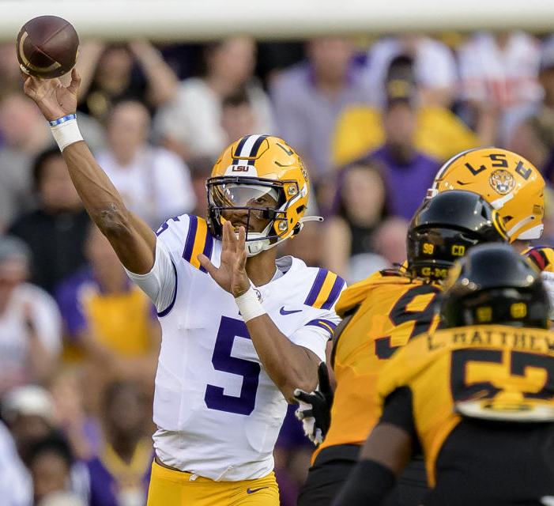
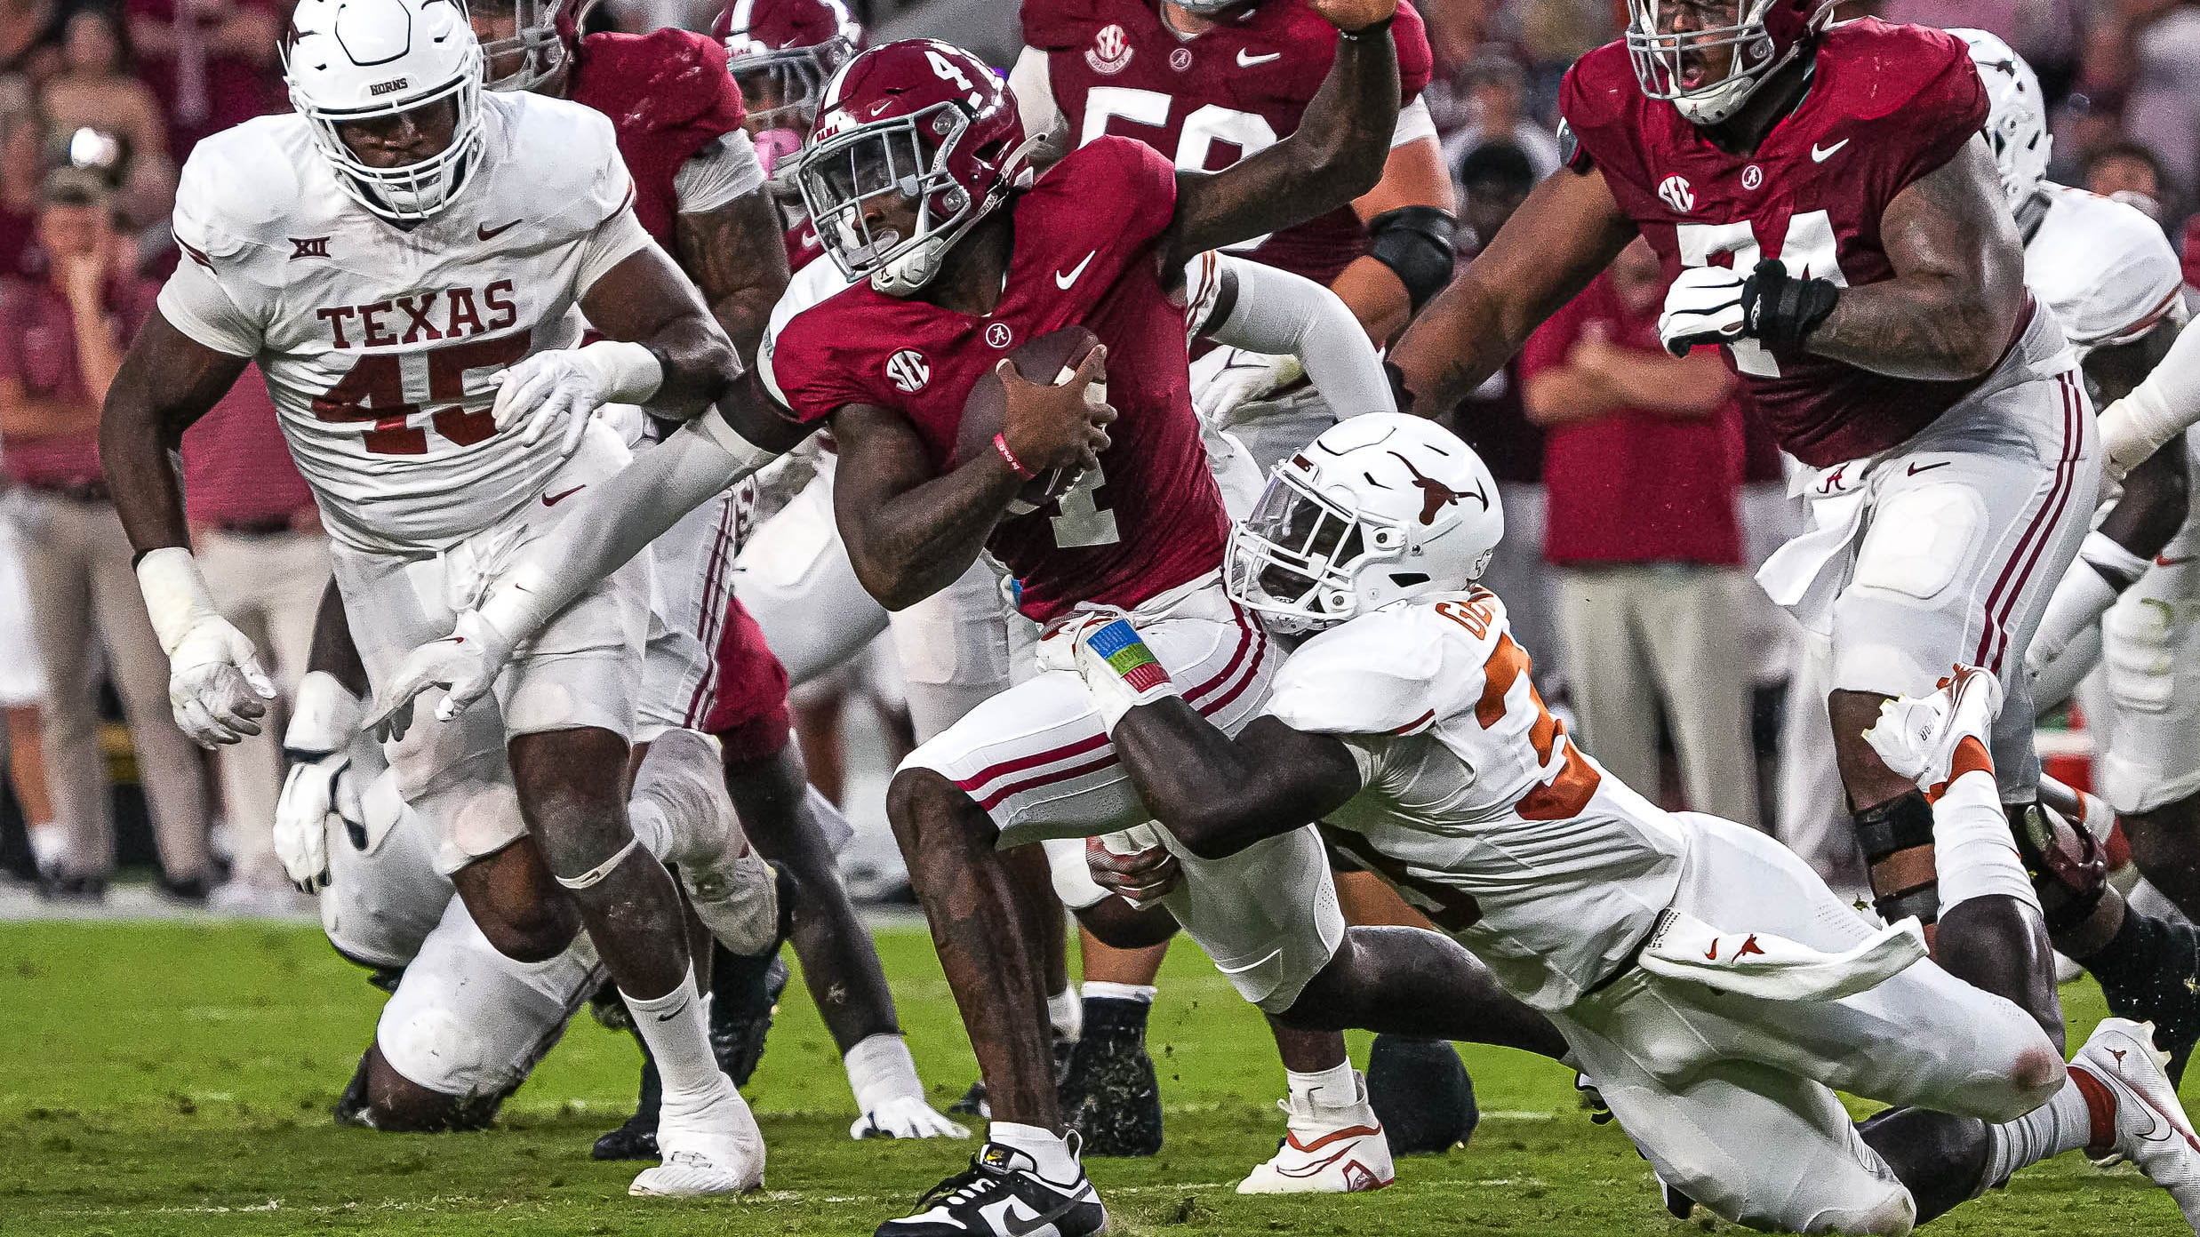
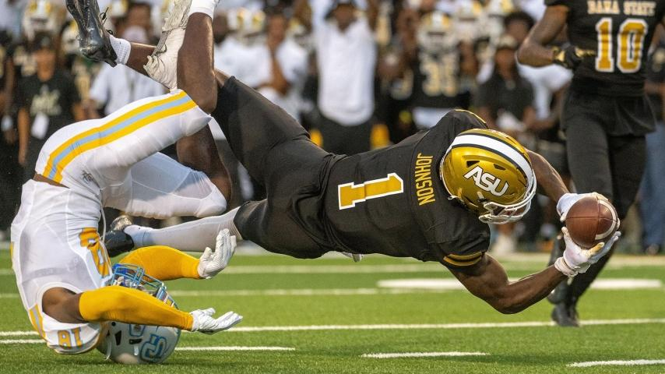

Slide 16

IT’S TIME
COLLEGE FOOTBALL
ALL SEASON LONG
Notes:
“It’s time” fades in
Music fades out
Espn logo fades in

